Slide 1
Index of Difficulty Measurement for Handedness in Human Computer Interaction
Kathleen Brush, Aditee Verma, Sadida Siddiqui, John Sheridan, Avery Leider and Charles Tappert
Seidenberg School of CSIS, Pace University, Pleasantville, New York
{kb31851p, av11813n, ss05380p, js58363p, aleider, ctappert} @pace.edu

Slide 2
Problem Statement
Study the Index of Difficulty Measurement for Handedness in Human Computer Interaction
By using Fitts’ law and Steering law, we devised three experiments to gather meaningful data from equal number of right-handed and left-handed subjects
The data gathered is analyzed to provide reasonable biometric authentication application

Slide 3
Objectives
Cross-platform mobile app using Flutter is developed to gather data points
First experiment captures the time to reach and click a target point, distance to target point, and its width in each of the four quadrants on the display
Second experiment measures accuracy via timing features and touchscreen features with dropdown menu
Experiment three checks for screen visibility. Timing and response speed are addressed by designing mirror image screens asking subject to click on specified object from each image

Slide 4
Objectives
Experiments are conducted on equal number of self-identified right and left-handed subjects
Since the app is cross-platform, experiments are also conducted on equal number of Android and Apple devices
Data points are collected and stored in Firebase database in json format
Data collected is analyzed to see if it yields an authentication biometric using data visualization and machine learning

Slide 5
Introduction
Touchscreens on laptop, tablets, mobile phones are obscured by left access points
They are designed for the right handed
Very little public awareness of left-handed accessibility and accommodation in computer hardware and software interfaces

Slide 6
Laterality HCI Issues And Handedness
91% Right Dominant
9% Left Dominant

Slide 7
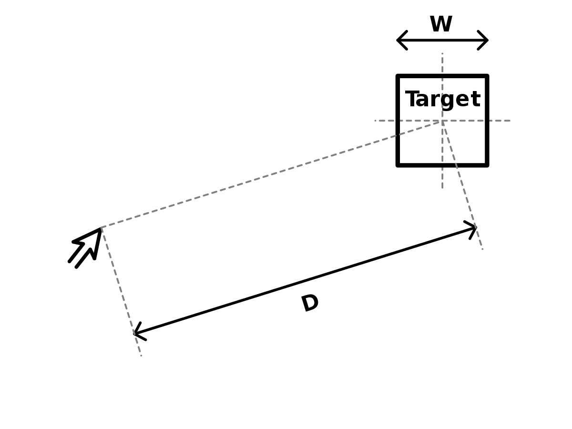
Fitts’ Law
Fitts’ law calculates the time to click a point on the screen as a function of the distance traveled and width of the target
Used in HCI to design UI/UX of mobile apps

Slide 8
Fitts’ Law - Mathematically
𝑴𝑻 = 𝒂+𝒃 ∙ 𝐥𝐨𝐠2( D/𝑾 )
MT refers to the movement time = start time – end time
D refers to moving range
W refers to the breadth of the target
The coefficients a and b will be determined by experiment
log2(D/W) is called difficulty coefficient, represented by ID
The linear representation of Fitts' law is: MT = a + b . ID

Slide 9
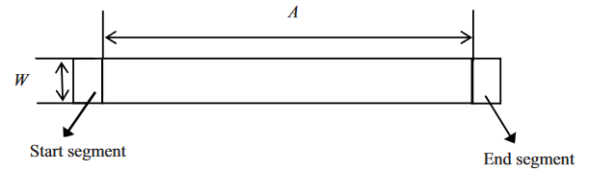
Steering Law
Derived from Fitts’ Law
Used to calculate accuracy
Predictive model of subject movement that describes the time required to navigate or steer through a tunnel
Mathematically,
IDs = A/W
where A = length of the tunnel and W = width

Slide 10
Hypothesis I
There will be an equal and opposite, or mirror difference for right-handed and left-handed subjects
We will extend Cheng Zhang, et al’s paper, "An experimental research on the directivity of Fitts' law in human-computer interaction," (2015) for our research’s first experiment
A walking menu and screen designed with text and buttons, along with their mirror images, will be navigated and measured using Steering Law
After these data points are collected, we will analyze for each category by dominant hand to see if there is a difference between speed and accuracy results for right and left

Slide 11

Flutter
The multi-platform mobile app is built using Flutter
It is a product by Google which facilitates building of apps faster
This development SDK is chosen because it is open source, it creates cross platform apps and it has hot reload, meaning as soon as we make any change in the code, it gets reflected on the simulator
Uses Material Design which is the design language and it makes the UI aesthetically pleasant and distinctive

Slide 12
Designing the App Mockflow
For designing the wireframes of the mobile app, Mockflow, which is an online wireframe tool is used
All the screens were first created using Mockflow and then reviewed by the client and were further improved
Finalized wireframes were then developed using Flutter

Slide 13
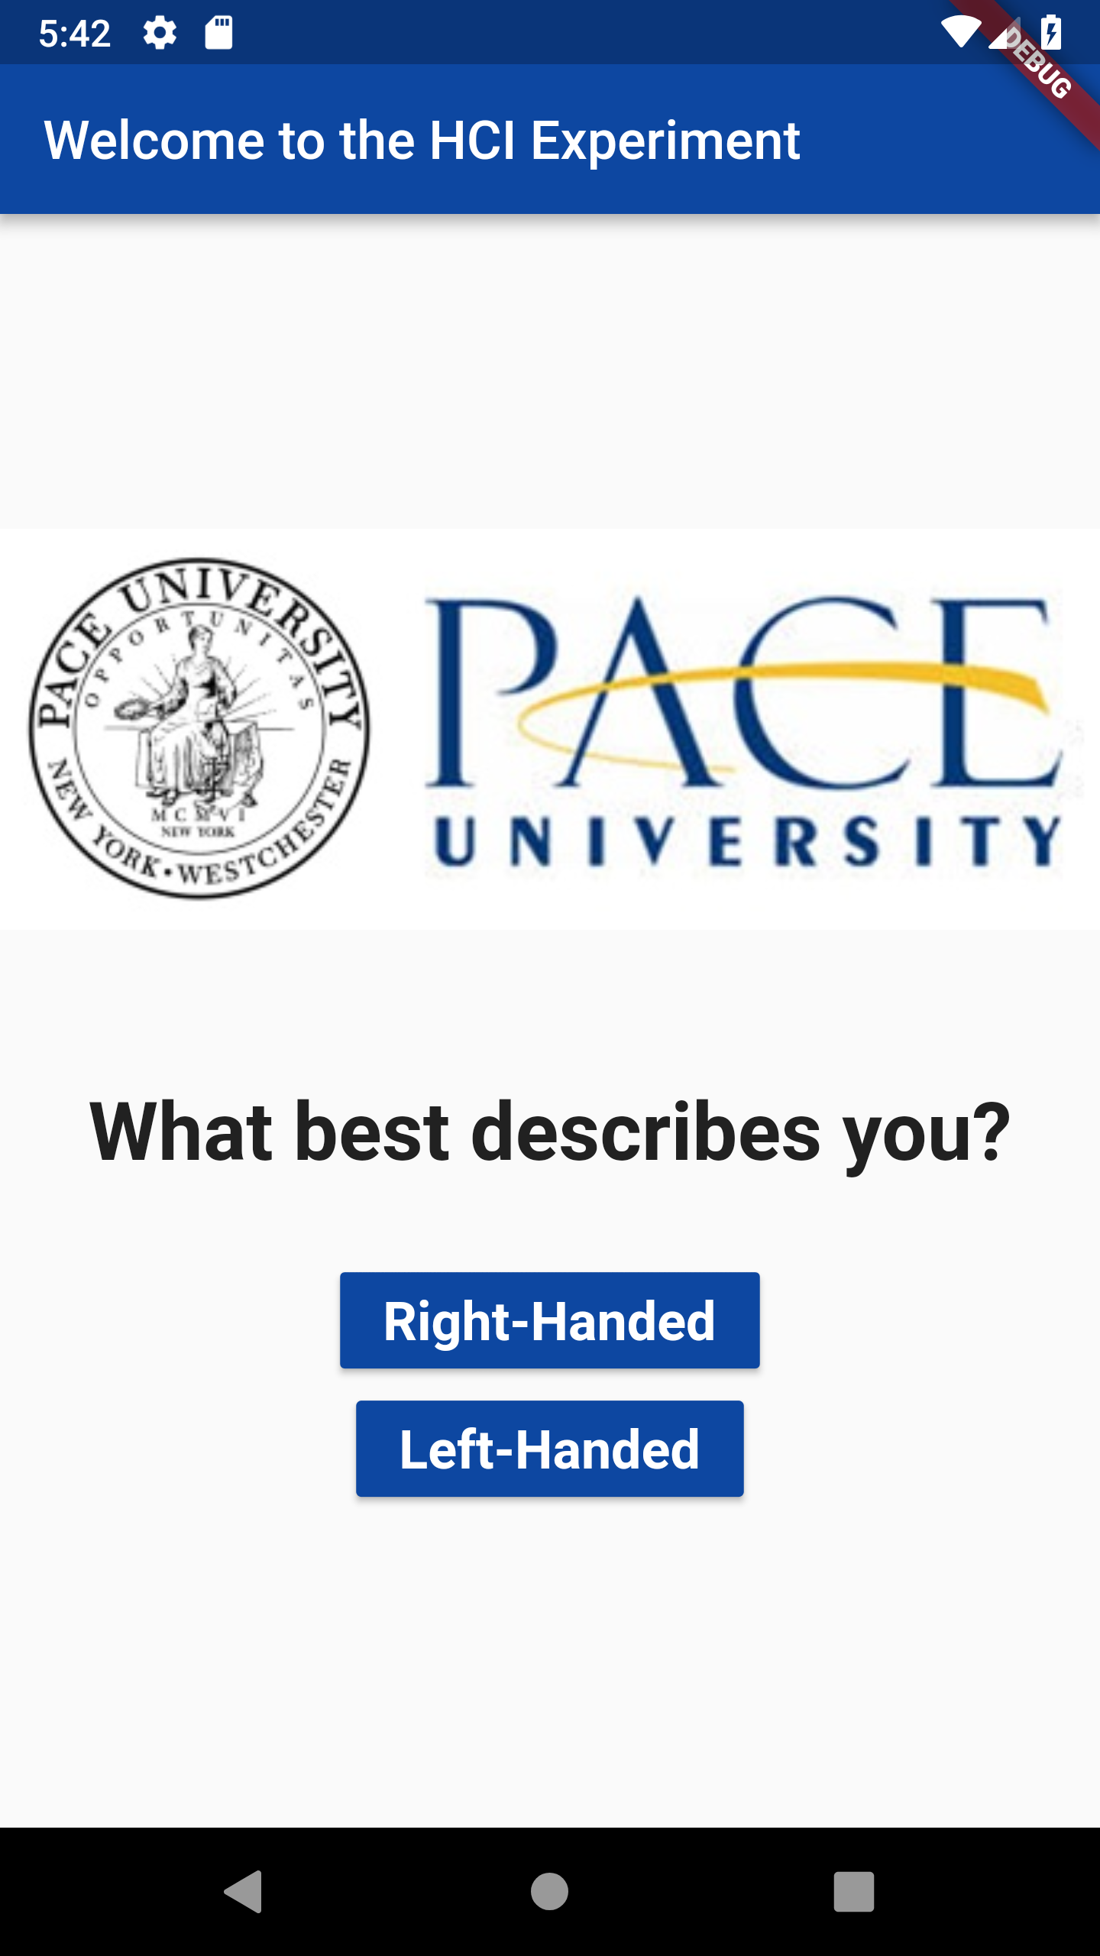
HomePage

Slide 14
Experiments
We are extending the experiments by including dominant hand information, as well as an equal number of right-handed and left-handed subjects
The subject will be asked to use their declared dominant hand and will be observed doing so
They will be later asked to repeat the experiment with their non-dominant hand as well

Slide 15
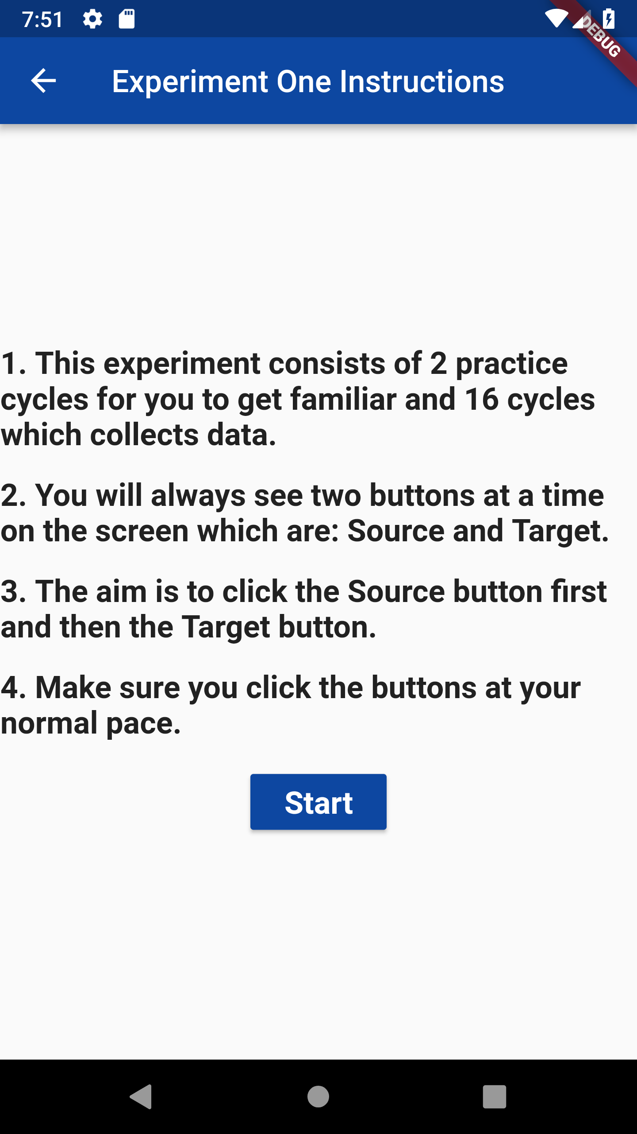
Experiment One: Instruction Screen

Slide 16
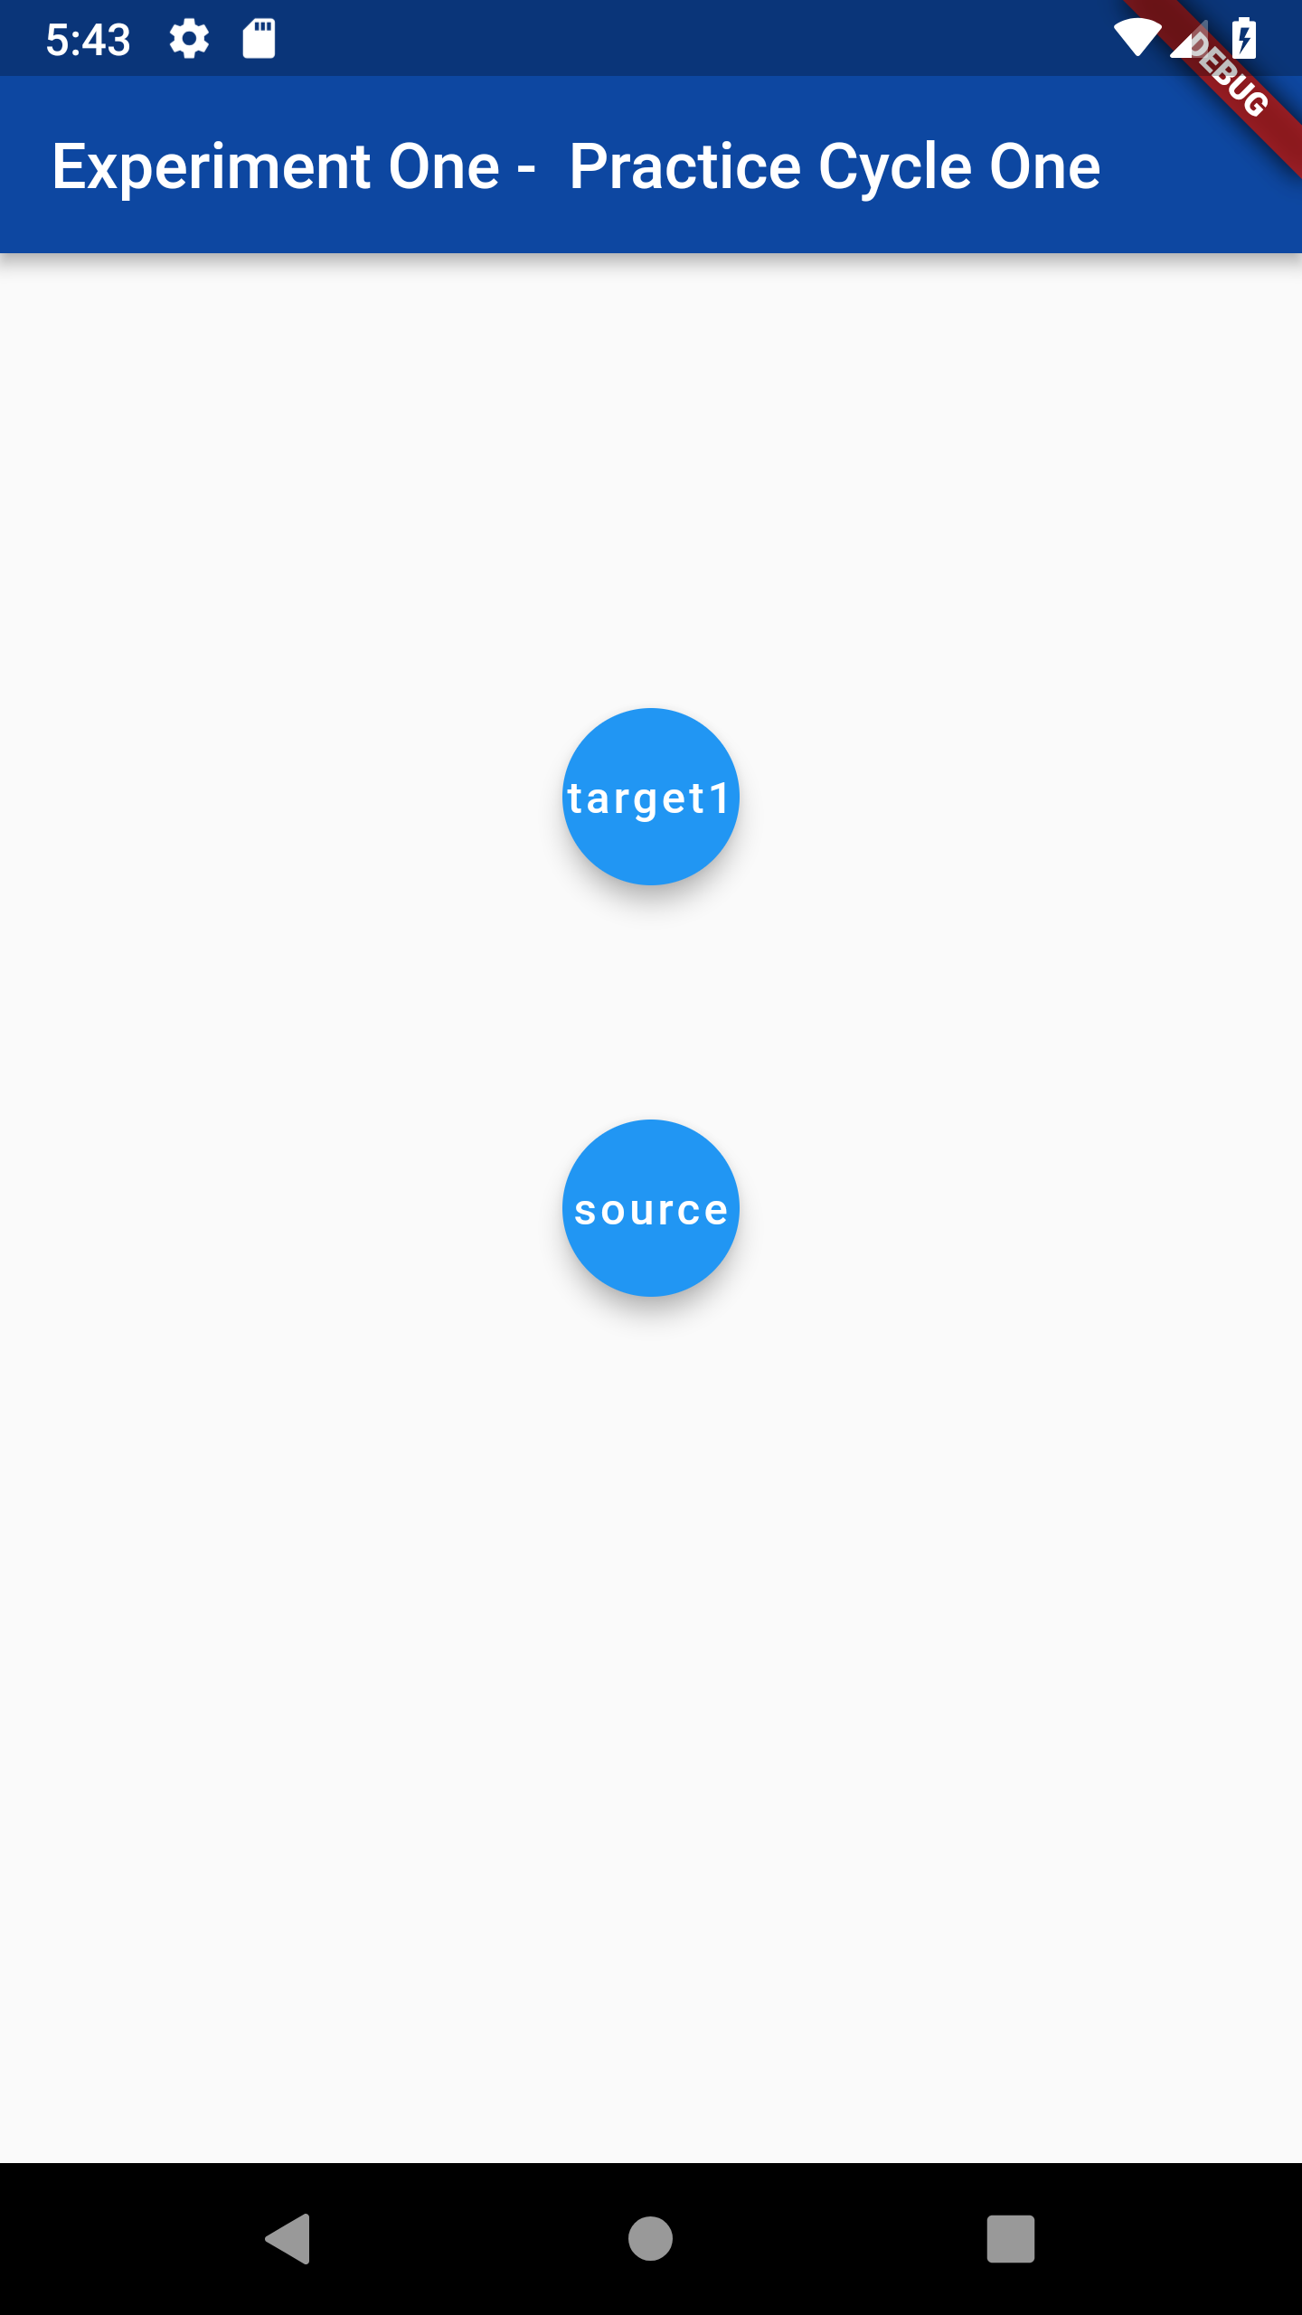
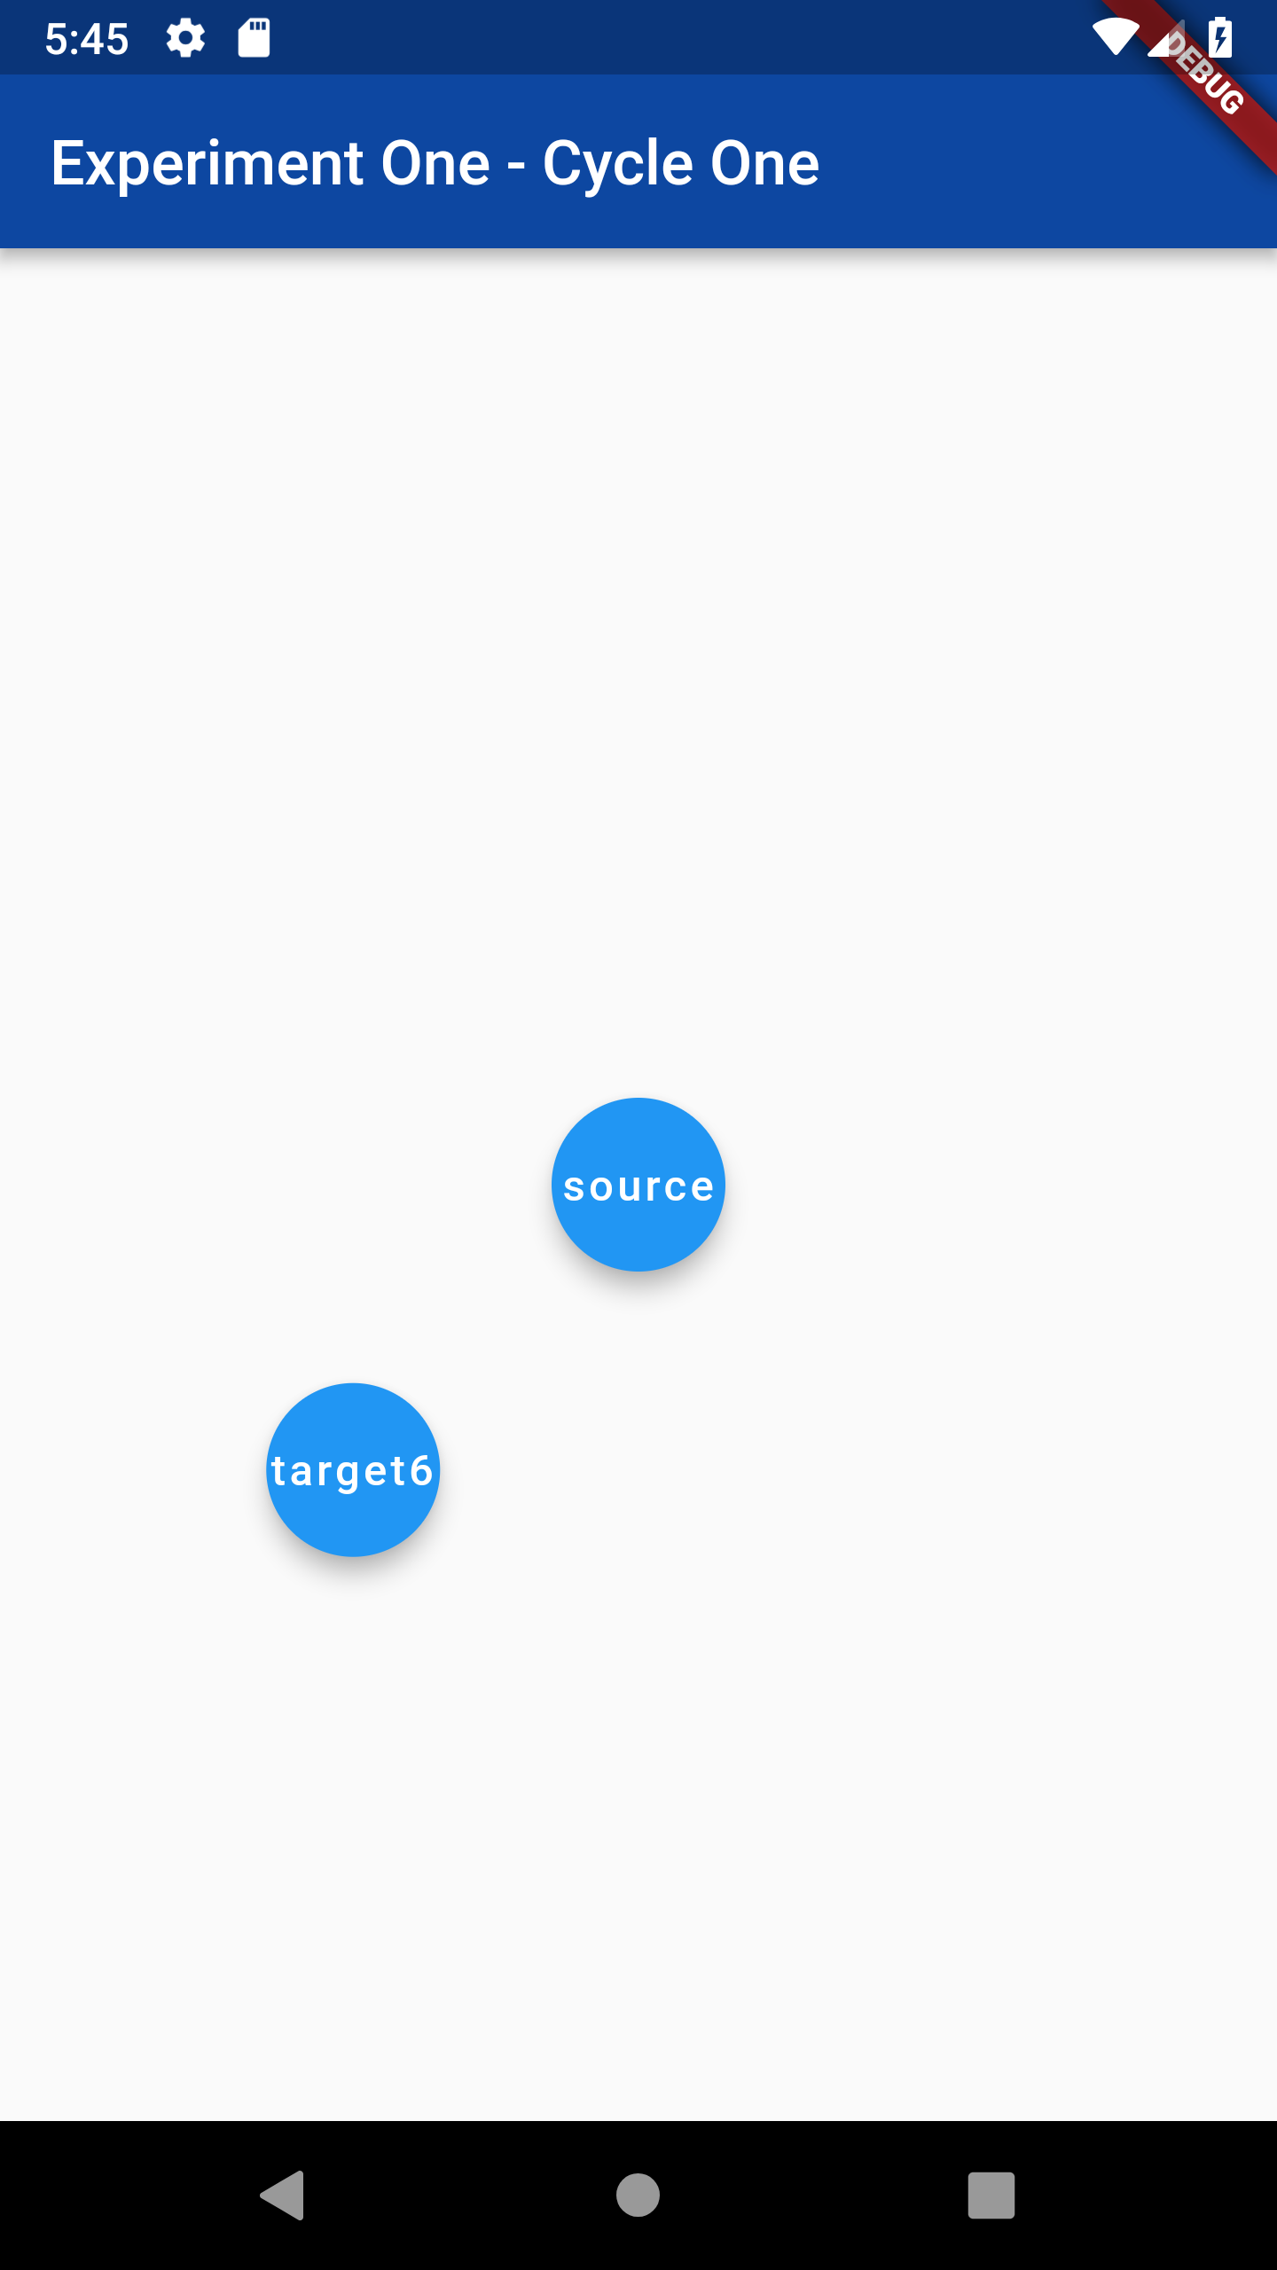
Experiment One

Slide 17
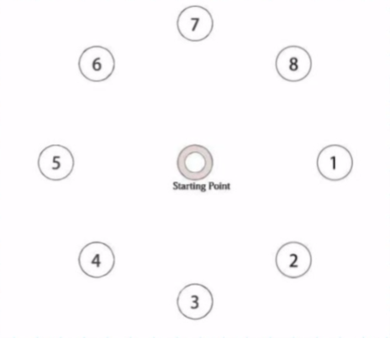
Experiment One
This experiment determines the difficulty coefficient by using time to reach and click a target point, distance to target point, and its width in each of the four quadrants on the display
There are eight target points, each 250 pixels from the start point (0,0) at 45-degree rotation intervals
Only one target point appears on screen at a time
The target points are 60 pixels (a circle with a 30-pixel radius)

Slide 18
Experiment One
One click task consists of clicking the start point and then the target point with a fingertip
When all eight target click tasks are done, that completes one cycle test
The experiment consists of eighteen cycle tests
The first two cycles are practice sessions and not included in the analysis for each subject
Timing features and touchscreen features such as screen location points are captured and recorded for each subject’s entire eighteen cycle tests

Slide 19
Experiment One
Distance and width data points are entered into to the Fitts’ Law equation to measure duration
This experiment aims to prove that if a certain quadrant is difficult to access for right handed subject, it will be easy for left handed subject
Index of Difficulty and accessibility are the mirror images for each hand

Slide 20
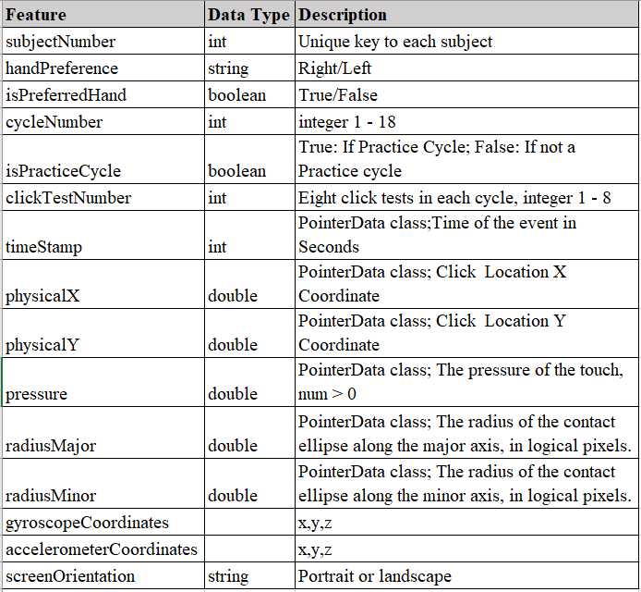
Experiment One: Data Points Collected

Slide 21
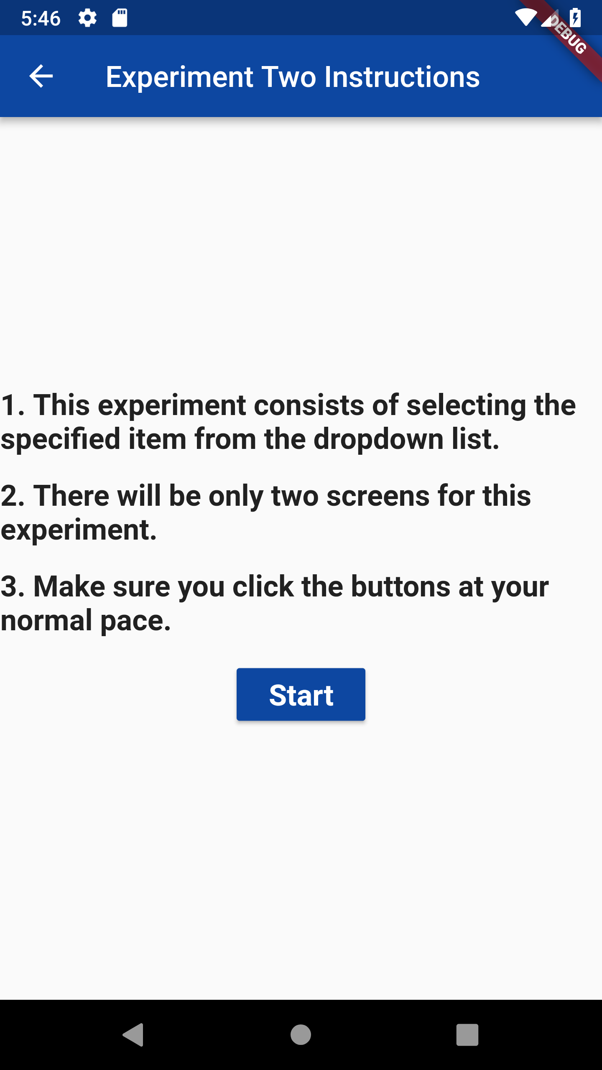
Experiment Two: Instruction Screen

Slide 22
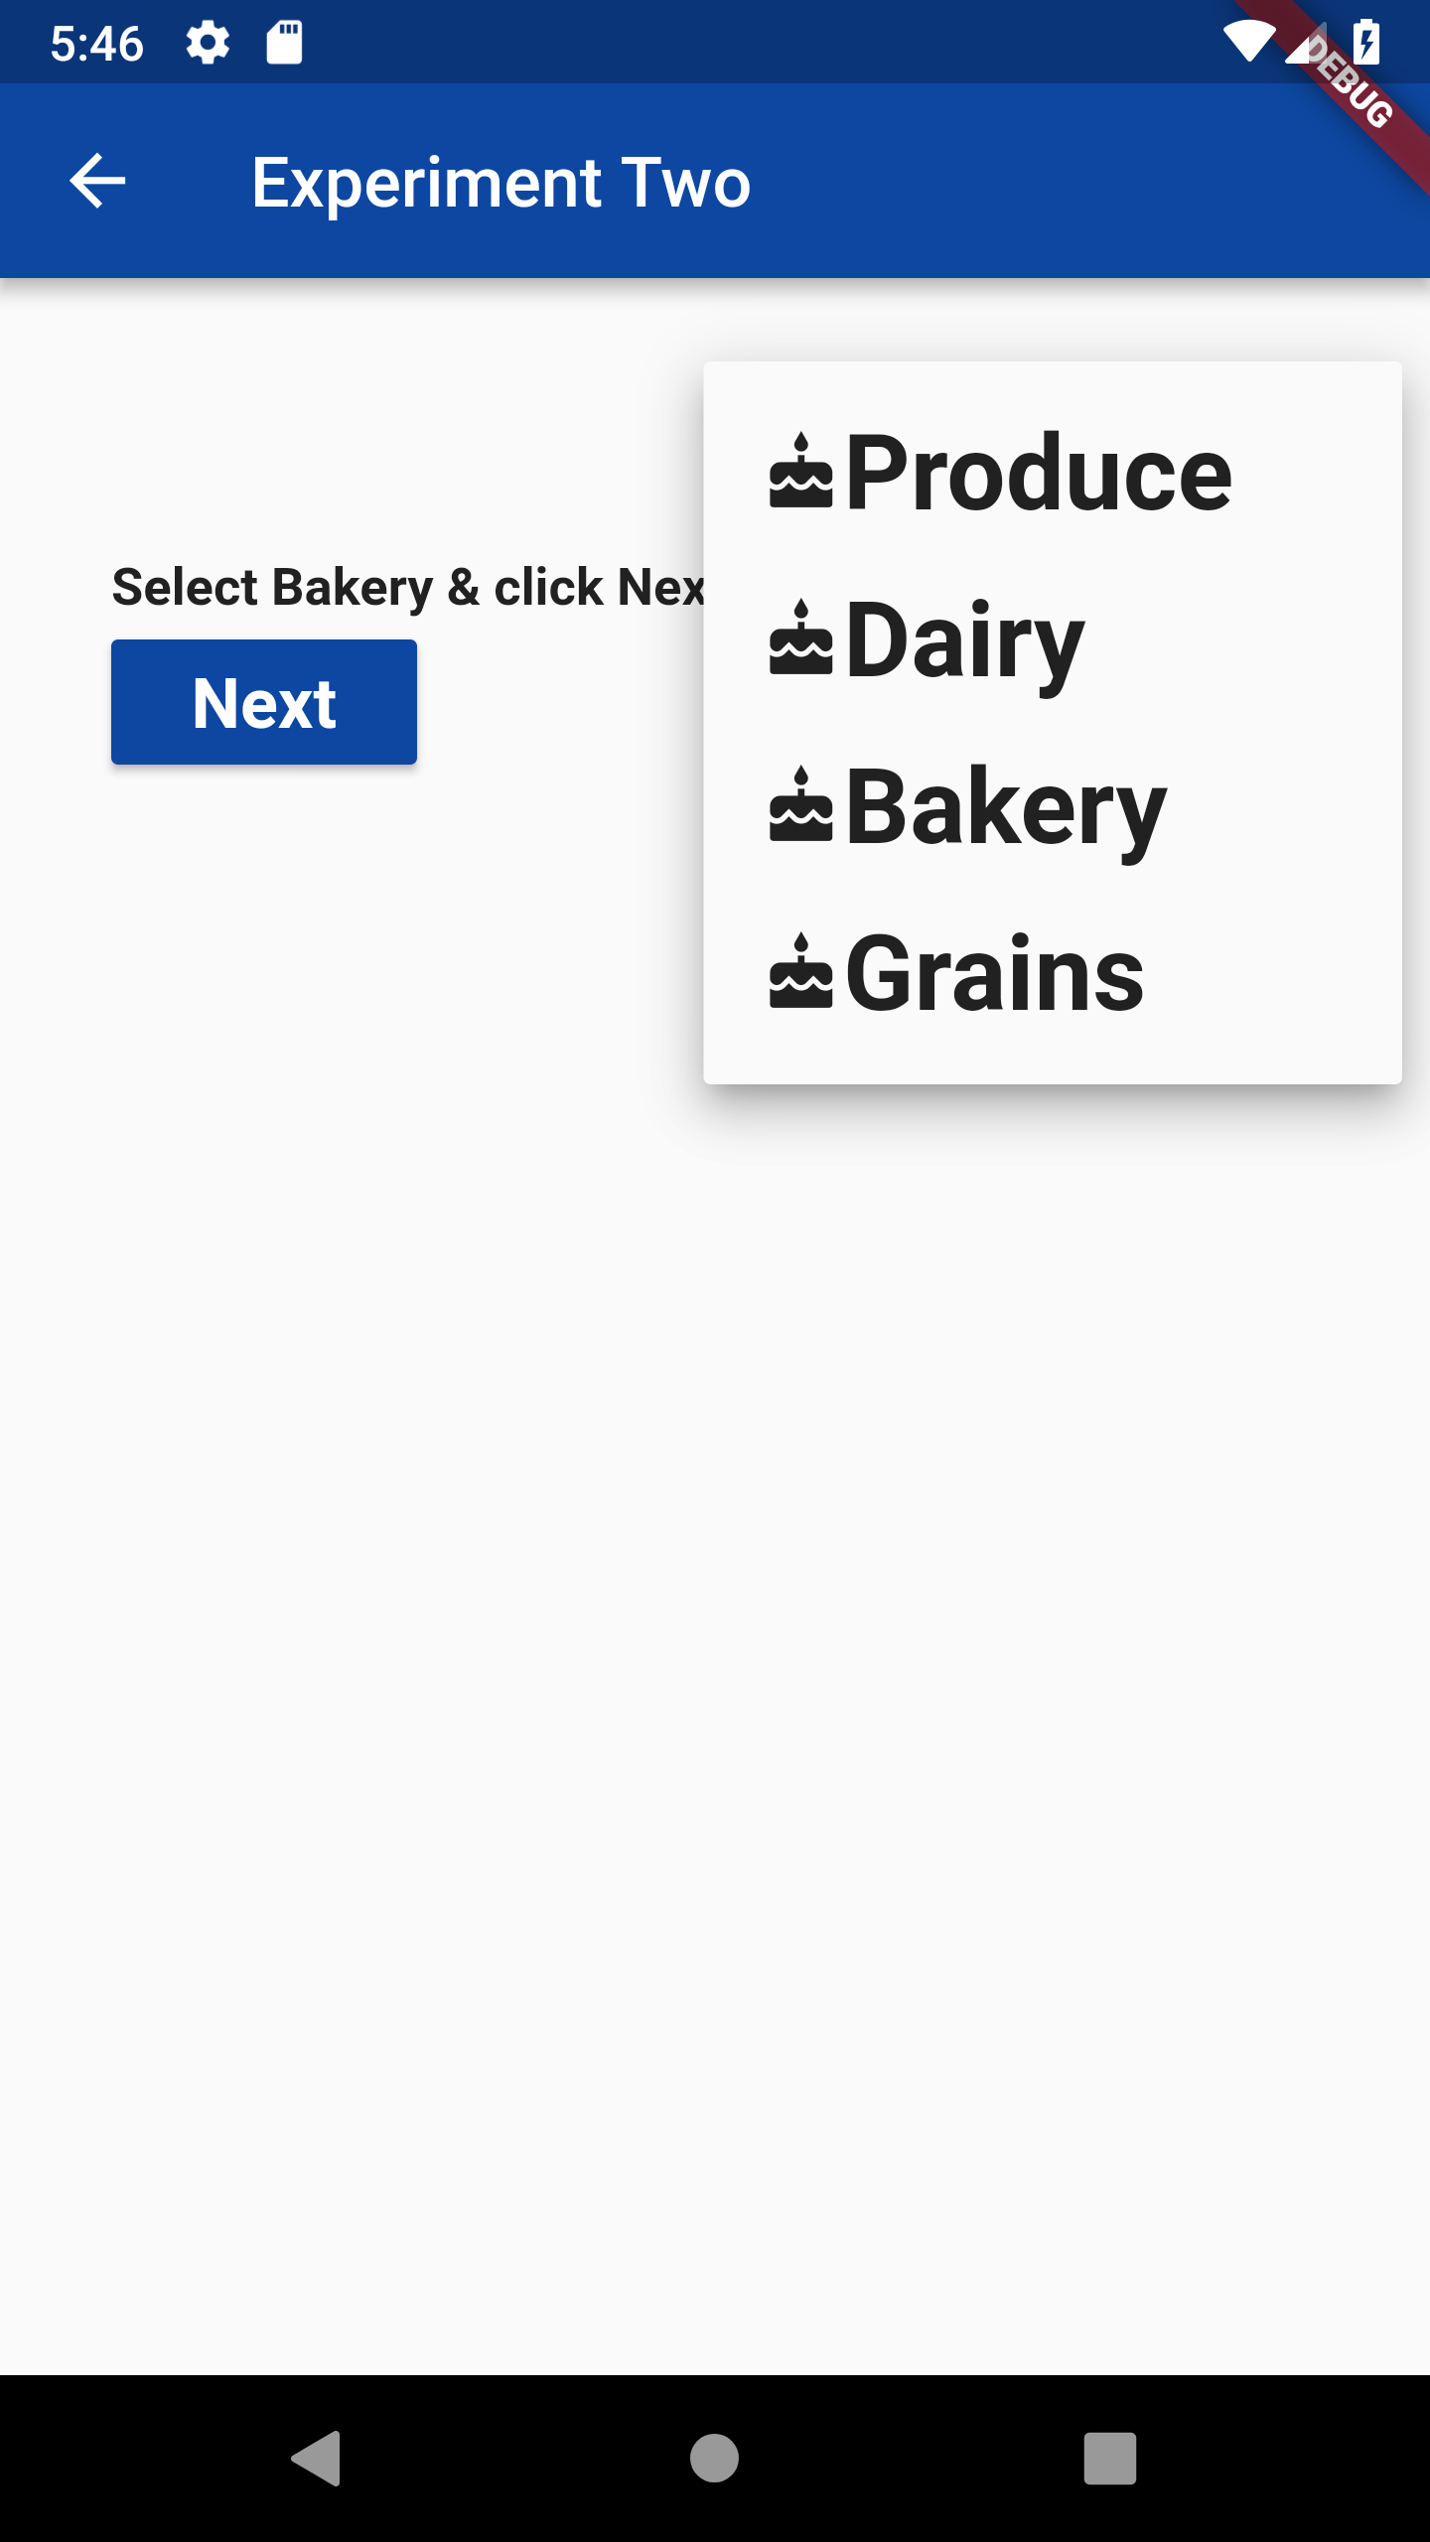
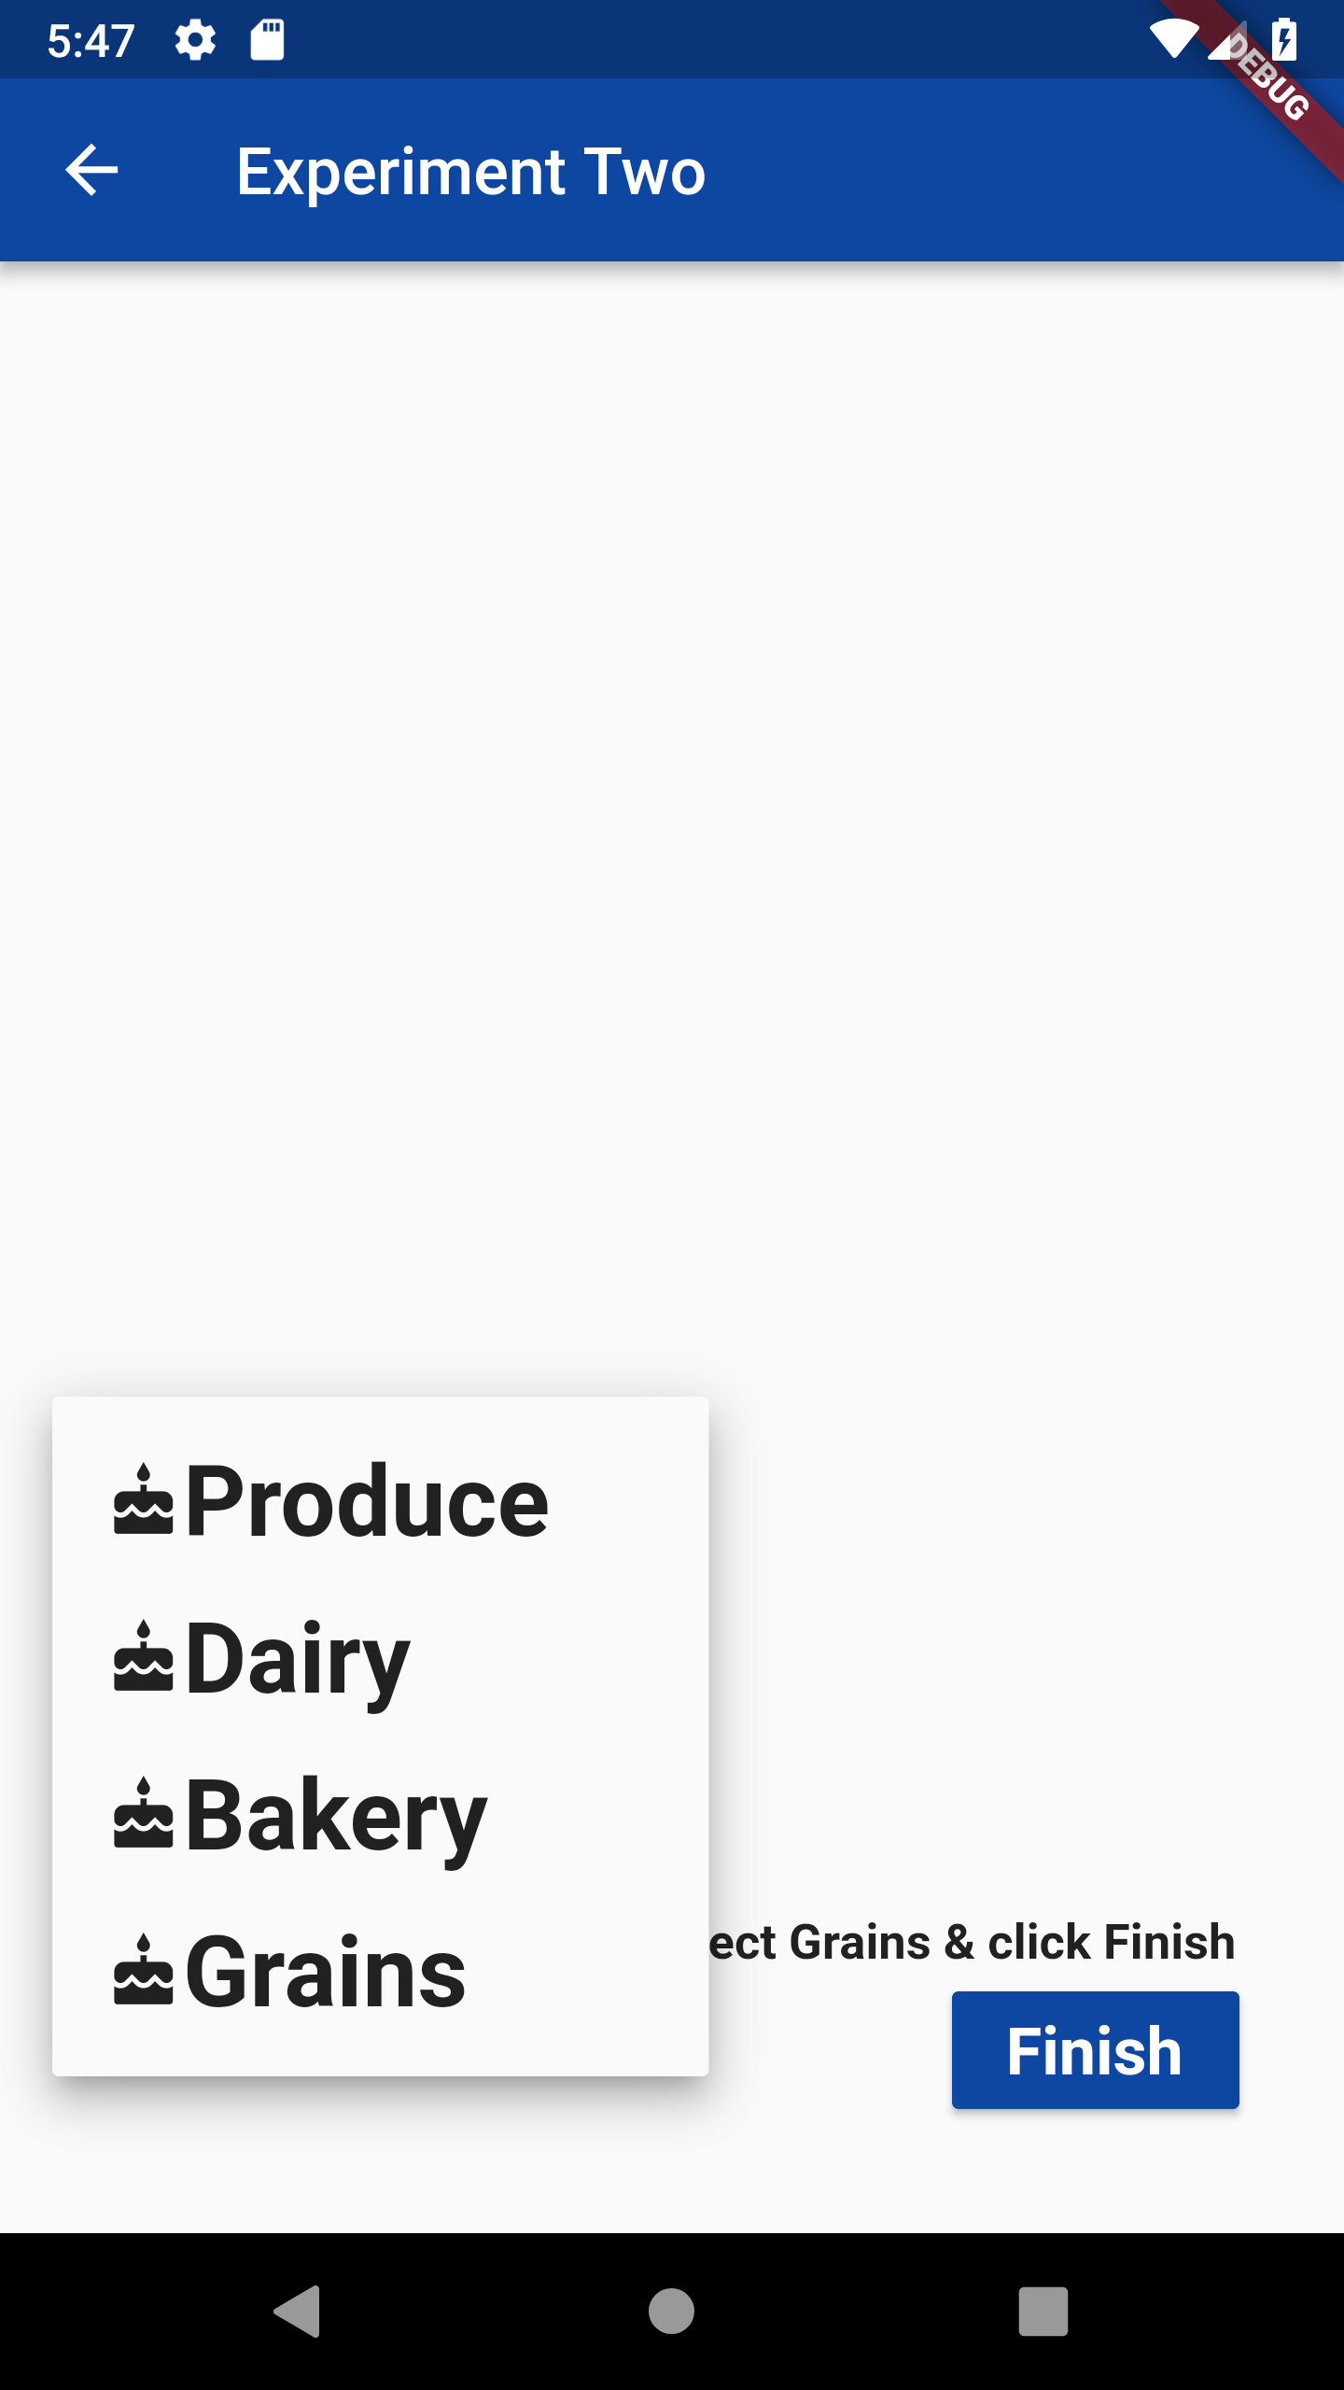
Experiment Two

Slide 23
Experiment Two
Accuracy is measured via timing features and touchscreen features using dropdown menus
Ideally a stair step selection menu also known as cascading menu had to be used for this experiment, but mobile apps do not have cascading menus. Hence dropdown menu is used for this experiment
First, the menu will travel from upper right to lower right. Second, the menu will travel from lower left to upper left
Steering Law is used to calculate the results

Slide 24
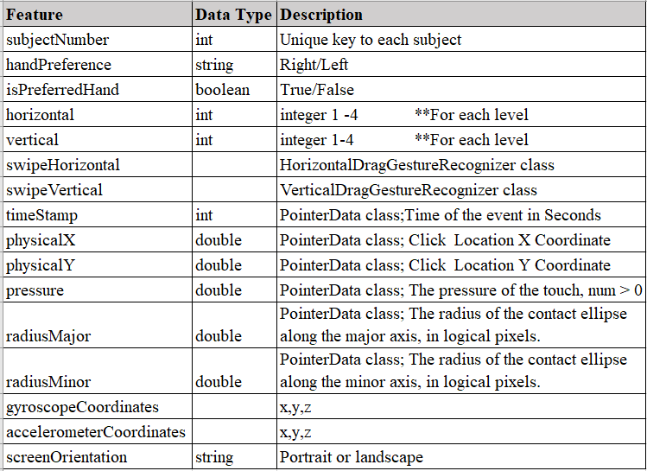
Experiment Two: Data Points Collected

Slide 25
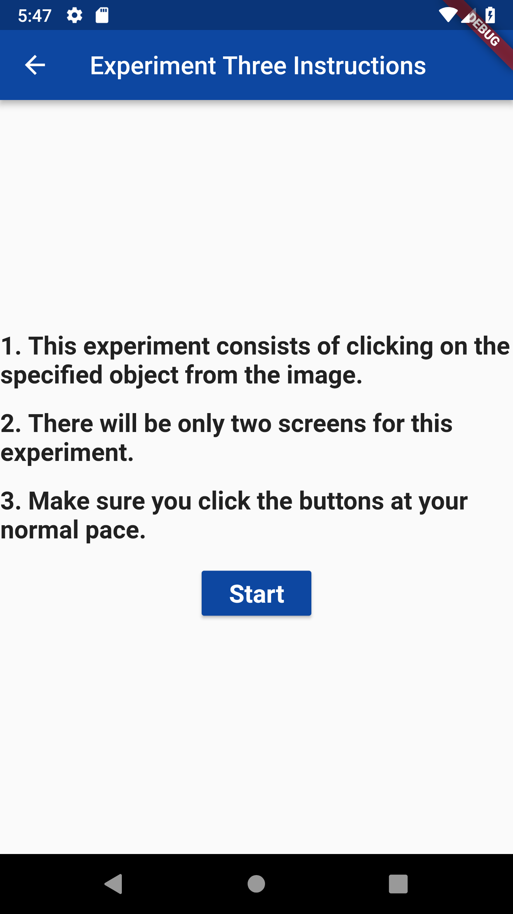
Experiment Three: Instruction Screen

Slide 26
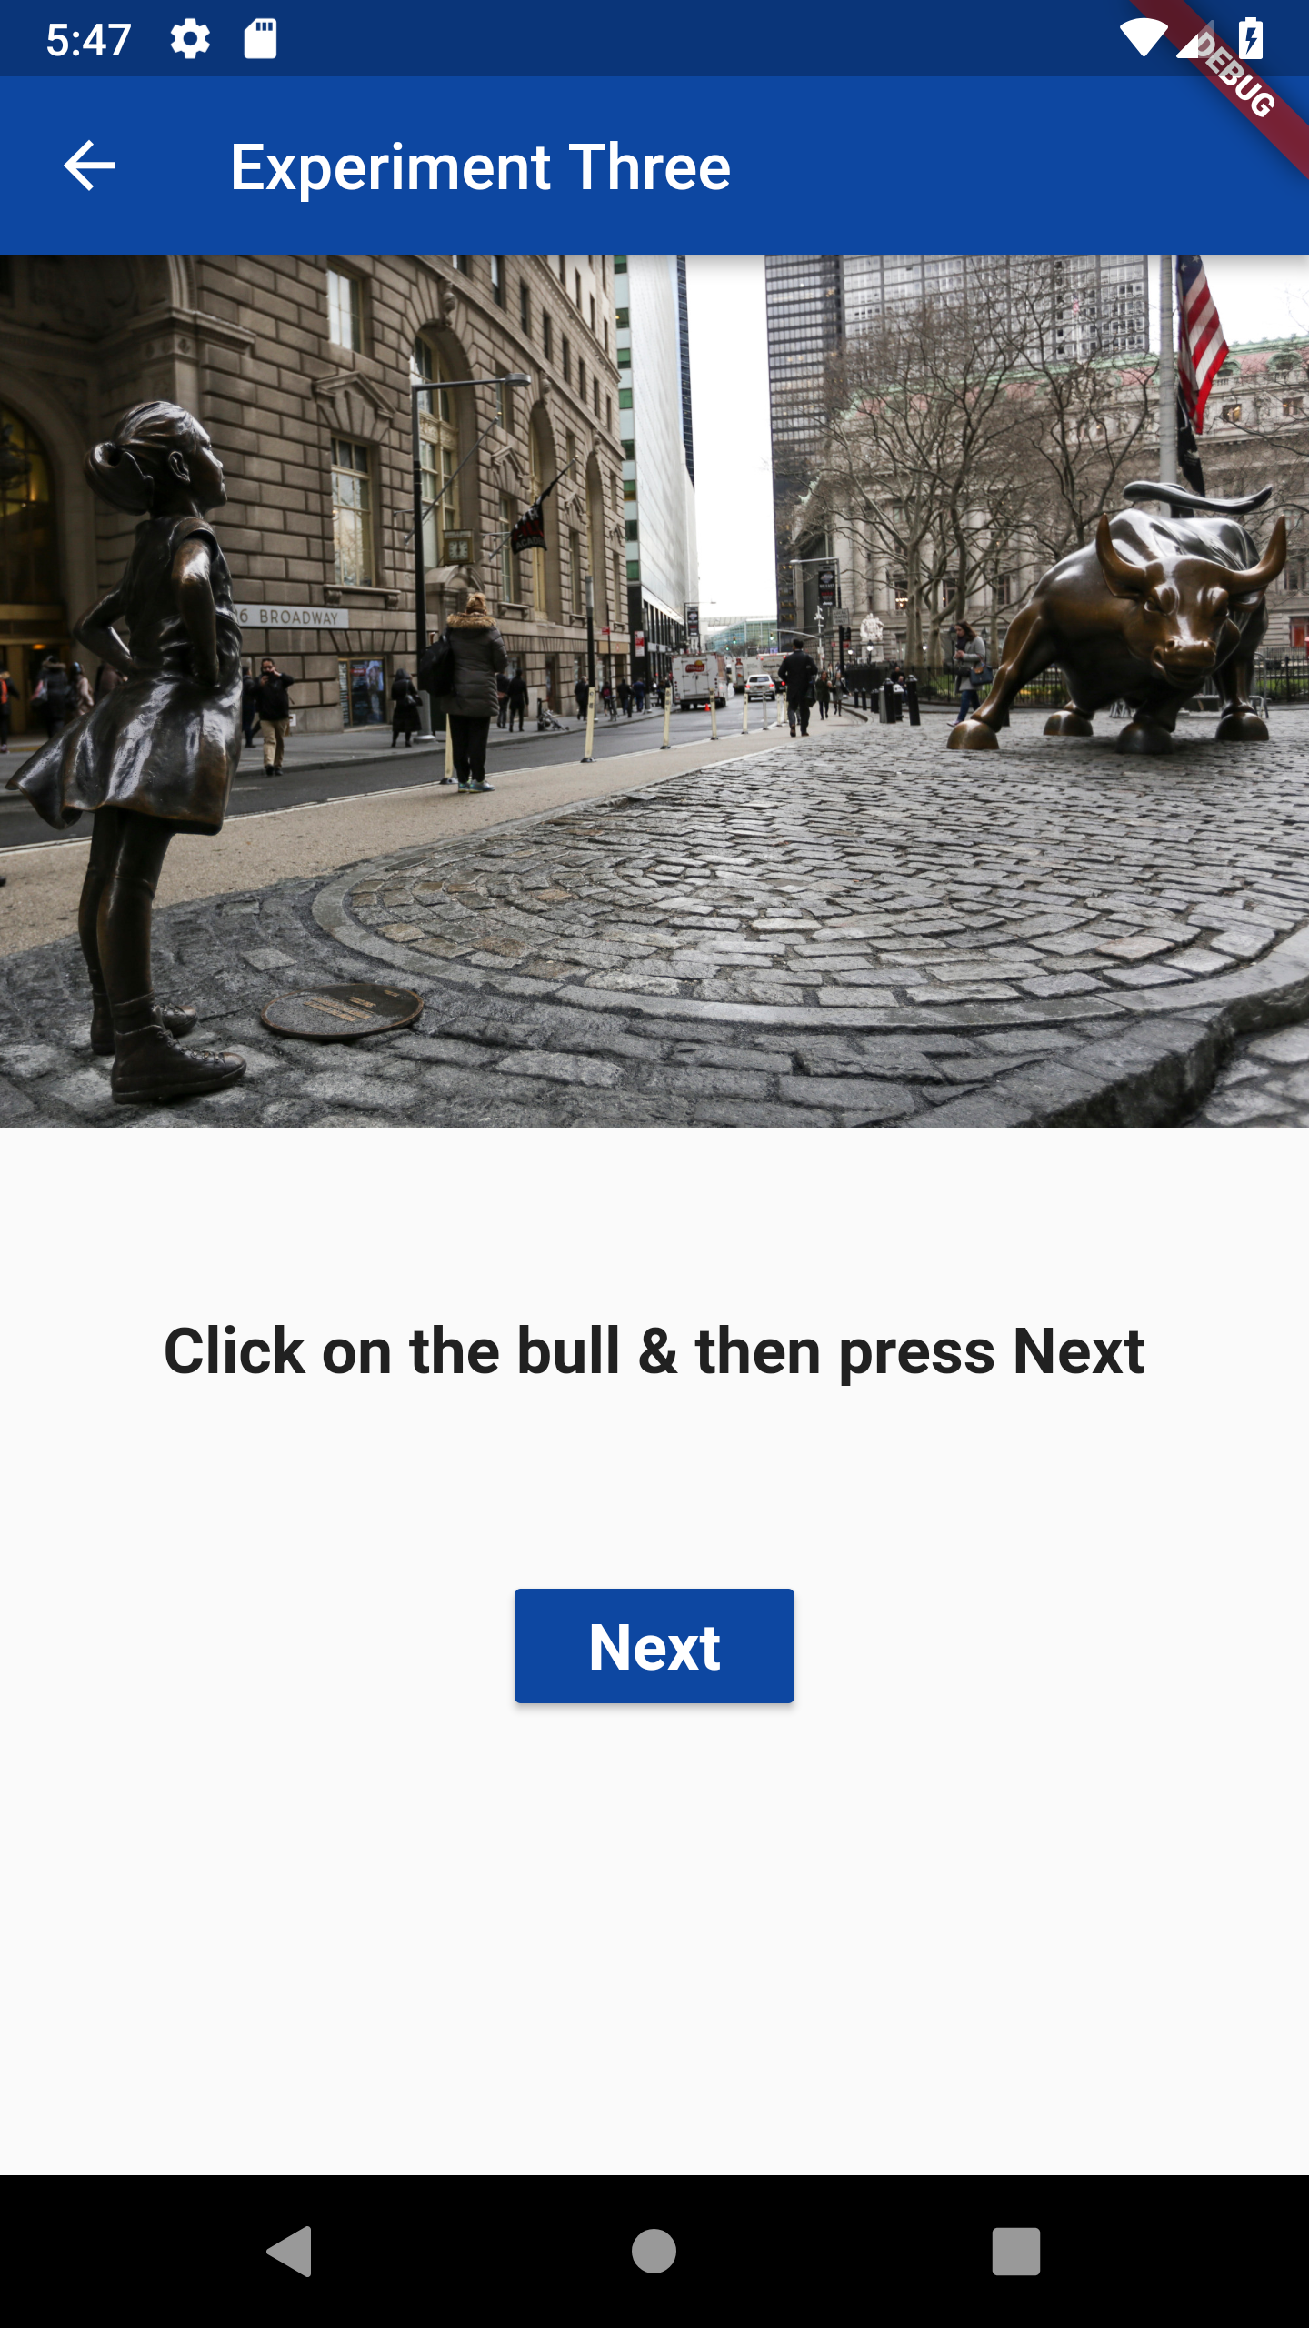
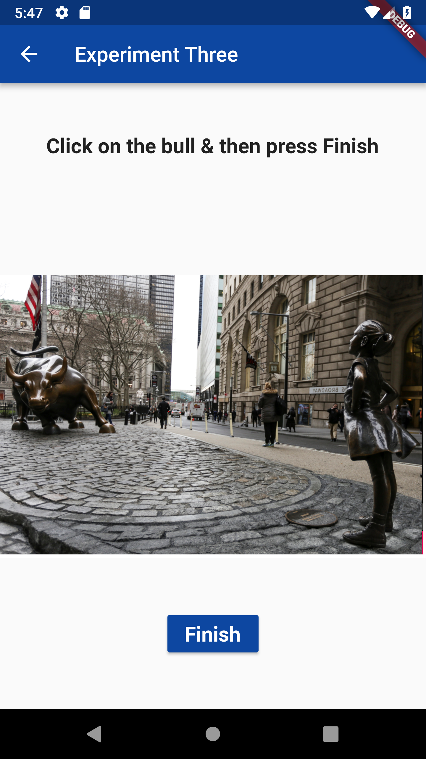
Experiment Three

Slide 27
Experiment Three
Screen visibility, timing, and response speed are addressed by a screen with an Image followed immediately by another screen presented to the subject with additional written instructions
A mirror image of this procedure displays next

Slide 28
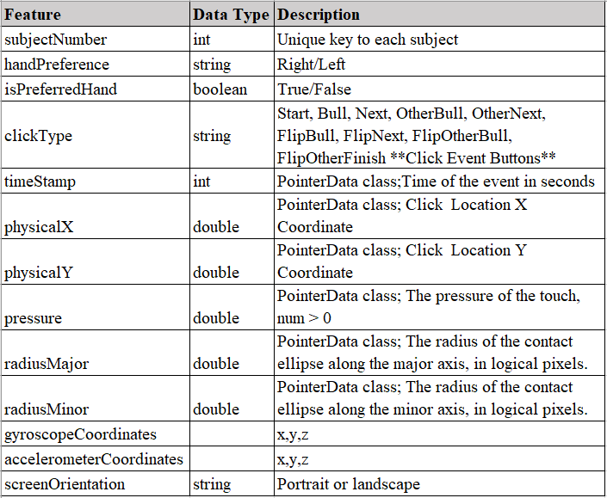
Experiment Three: Data Points Collected

Slide 29
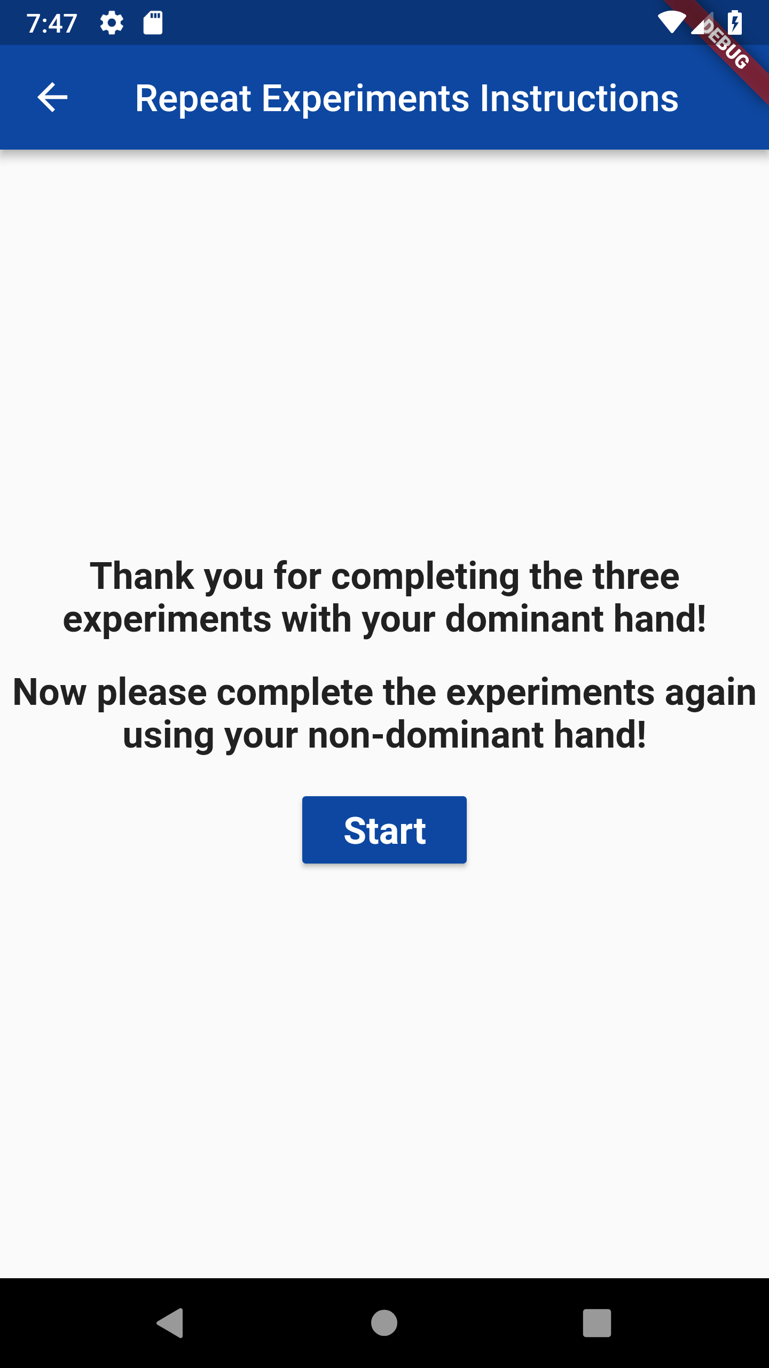
Experiment Repeat Instructions

Slide 30
Experiment Repeat Instructions
After all the three experiments are completed by the subject using the dominant hand, another screen is rendered on the screen to tell the subject to again start performing all the experiments using the non-dominant hand
When subject clicks on Start, they are taken to the experiment one instruction screen and the subject performs all the experiments again
The researcher is supposed to monitor that the subject is using the non-dominant hand this time.

Slide 31
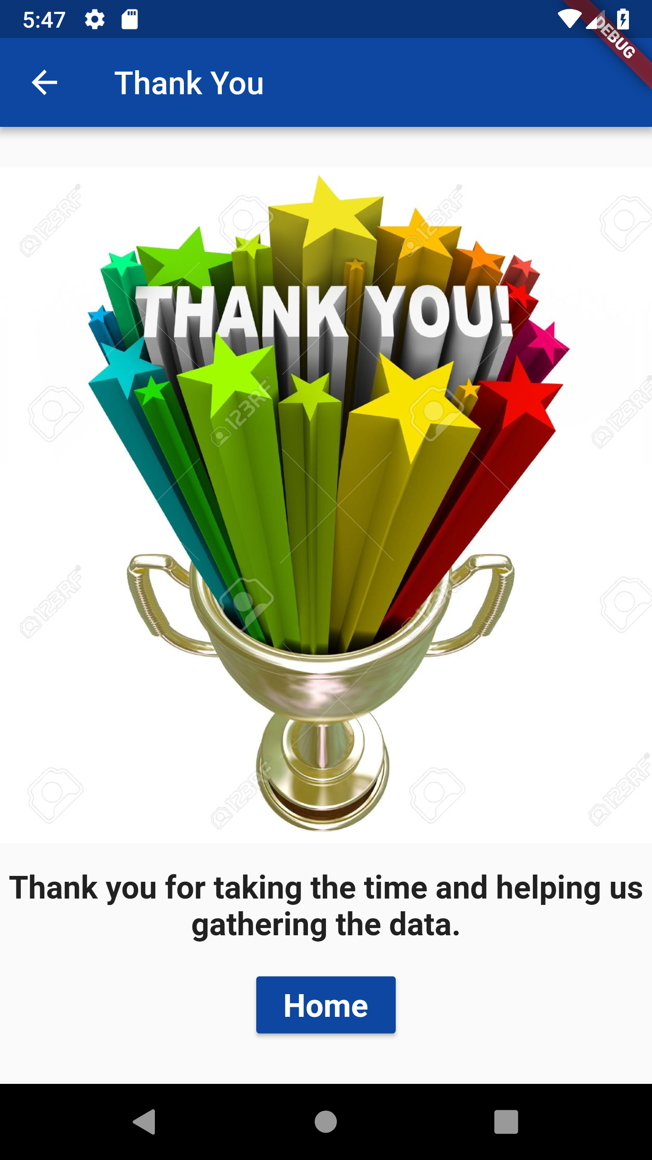
Thank You Screen

Slide 32
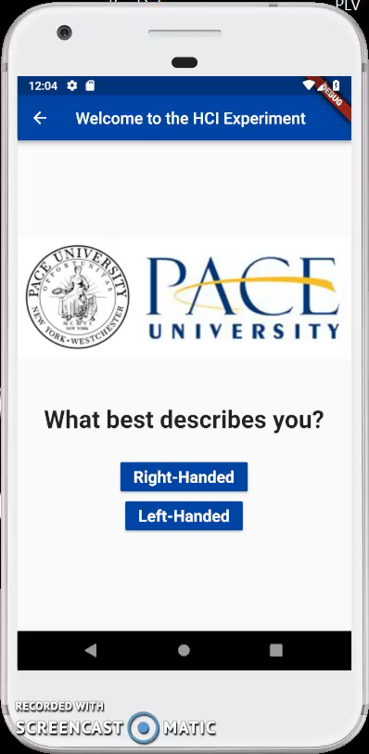
App Demo

Slide 33
Hypothesis II
Mobile devices’ native touchscreen and timing features will yield authentication biometrics for each subject
Authentication - Phase 2 will use data visualization machine learning on each user to see if these yield any significant authenticating biometrics
Built-in sensors:
Gyroscope and Accelerometer
Flutter pressure property

Slide 34

Firebase: Backend
The backend used in the Flutter app is Firebase which stores data in json format
While the experiments are conducted on the subject several screen features listed for each experiment are been recorded in the database

Slide 35

Python Libraries Used
Python is used for data visualization and machine learning
Matplotlib is a 2D plotting library. It offers data visualizations in the form of histograms, power spectra, bar charts, and scatterplots with minimal coding lines

Slide 36
Data Analysis
Since the time was limited the data collected is quite limited and the data analysis was not possible for all the experiments and features
The most important experiment which is experiment one and the most important feature which is time duration is picked for data visualization
A total of four subjects: two right handed and two left handed helped and performed the experiments
Just to have an overview of how handedness affects the human computer interaction using the data collected and the feature of time duration, data visualization using a graph is done

Slide 37
Data Analysis
The average value out of eight clickTestNumber is calculated for first eight cycles for each of the four users, giving us eight time-values per cycle
It was done separately for the right-handed and left-handed subjects
Matplotlib is used to plot a graph which shows how fast or slow the subjects were to each other.

Slide 38
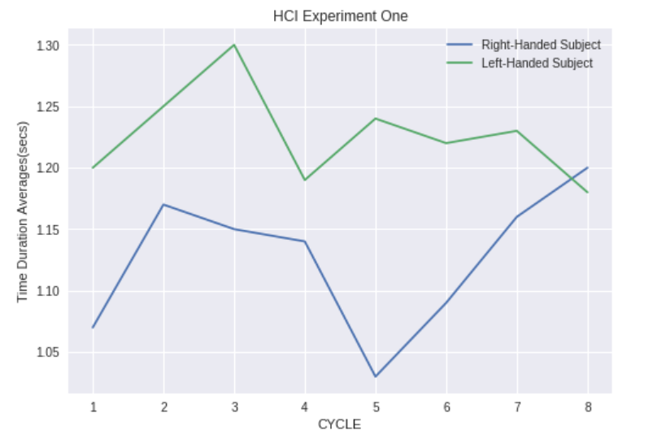
Data Analysis
Figure shows the graph between the average time duration for first eight cycles for right-handed and left-handed subjects
The blue line is plotting the data points for right-handed subjects and the green line is for the left-handed subjects

Slide 39
Results
It must be noted that the graph is not very reliable to conclude results as the data collected is limited
Nevertheless, if observed closely both the lines are the mirror image of each other which shows that the coordinates which are most easily accessible for a right-handed subject was the mirror image for the left-handed subject
Also, the average time taken by the right-handed subject to conduct the experiment is lower than what was taken by the left-handed subject

Slide 40
Results
Also, the experiment recorded the major and minor radius of eclipse formed by the subject during each of press and release events individually for each hand, right and left
The objective was to study if there is a pattern formed that would elicit the distinction of subject behavior when they use their dominant hand and when they use their other hand
It was found that there was no significant difference (in major) in press and release radius of the eclipse formed during a particular hit moment using a non-dominant hand compared to dominant hand

Slide 41
Results
Hence it can be inferred that the subjects faced problem while using their non-dominant hand to hit a particular target as their press and release eclipse didn’t differ much, so the results suggest that subjects under test were not able to completely press the target using their non-dominant hand.

Slide 42
Future Scope
Data analysis using all the features must be completed for all the three experiments
Various features can be selected to be visualized using graphs to draw meaningful conclusions
Around twenty left-handed and right-handed subjects could be used to gather data of all three experiments to confirm the viability of the results
Experiment two must be modified to use a stair case selection rather than a single dropdown, because right now it’s not depicting the Steering law

Slide 43
Future Scope
More features could be recorded such as the device type (Android or Apple)
Researchers can also study what all experiments can be added to the existing three experiments employed in this paper.
Machine learning model can be employed further to discover the patterns in the data.

Slide 44
Summary of Project Meetings
Every week we met with our customer to make sure we are on the right path and to gain more understanding on our upcoming tasks
Mode of communication for meetings was Bluejeans and Skype
For day to day communications we used Slack
We maintain all the flutter code, python modules and csv files over github: https://github.com/averma74/FlutterAppOnHCI

Slide 45
References
Arif, A. S., “A survey on mobile text entry handedness: How do users input text on handheld devices while nomadic?,” 2012 4th International Conference on Intelligent Human Computer Interaction (IHCI), pp. 1-6, 2012.
Cheng Zhang, Xiaohuan Li, Fang Gao, Fadong Zhou, Li Xu, “An Experimental Research on the Directivity of Fitts’ Law in Human-computer Interaction,” 2015 IEEE International Conference on Progress in Informatics and Computing (PIC), pp. 226-229, 2015.
Coakley, M. J., Monaco, J. V., & Tappert, C. C., “Keystroke biometric studies with short numeric input on smartphones,” 2016 IEEE 8th International Conference on Biometrics Theory, Applications and Systems (BTAS), pp. 1-6, 2016.
Lefyer, K., & Spivak, A., “Method of person identification based on biometric characteristics of touch screen gestures,” 2017 20th Conference of Open Innovations Association (FRUCT), pp. 1-7, 2017. Monaco, J. V., Bakelman, N., Cha, S.-H., & Tappert, C. C., “Recent Advances in the Development of a Long-Text-Input Keystroke Biometric Authentication System for Arbitrary Text Input,” 2013 European Intelligence and Security Informatics Conference, p. 60-66, 2013.
Monaco, J. V., Bakelman, N., Cha, S.-H., & Tappert, C. C., “Recent Advances in the Development of a Long-Text-Input Keystroke Biometric Authentication System for Arbitrary Text Input,” 2013 European Intelligence and Security Informatics Conference, p. 60-66, 2013
Sartarelli, Marcello, “Handedness, Earnings, Ability and Personality. Evidence from the Lab”, PLoS ONE, pp. 1-17, 2017.
Zheng, N., Bai, K., Huang, H., & Wang, H., “You Are How You Touch: User Verification on Smartphones via Tapping Behaviors,” IEEE 22nd International Conference on Network Protocols, pp. 221-232, 2014.

Slide 46
References
Zhong, Y., Deng, Y., “A Survey on Keystroke Dynamics Biometrics: Approaches, Advances, and Evaluations,” Recent Adv. User Authentication Using Keystroke Dyn. Biometrics, chapter 1, vol. 2, pp. 1–22, 2015.
Bakelman, N., Monaco,J. V., Cha, S.-H., and Tappert, C. C., “Keystroke Biometric Studies on Password and Numeric Keypad Input,” 2013 Eur. Intell. Secur. Informatics Conf., pp. 204–207, Aug. 2013.
Maxion, R. A., and Killourhy, K. S., “Keystroke Biometrics with Number-Pad input,” Proc. Int. Conf. Dependable Syst. Networks, pp. 201–210, 2010.
Bartlow, N., Cukic, B., “Evaluating the Reliability of Credential Hardening through Keystroke Dynamics,” 17th International Symposium on Software Reliability Engineering (ISSRE), pages 117–126, 2006.
Cho, S., Han, C., Han, D.H., and Kim, H.I., “Web-Based Keystroke Dynamics Identity Veriﬁcation Using Neural Network,”. Journal of Organizational Computing and Electronic Commerce, 10(4), pp. 295–307, 2000.
Giot, R., El-Abed, M., and Rosenberger, C., “Web-Based Benchmark for Keystroke Dynamics Biometric Systems: A Statistical Analysis”, Eighth International Conference on Intelligent Information Hiding and Multimedia Signal Processing (IIHMSP), pp. 11–15, 2012.
Haider, S., Abbas, A., and Zaidi, A.K., “A multi-technique approach for user identiﬁcation through keystroke dynamics,” IEEE International Conference on Systems, Man, and Cybernetics (ICSMC), volume 2, pp. 1336–1341, 2000.
Hosseinzadeh, D., and Krishnan, S., “GaussianMixture Modeling of Keystroke Patterns for Biometric Applications,” IEEE Transactions on Systems, Man, and Cybernetics, Part C: Applications and Reviews, 38(6), pp. 816–826, 2008.

Slide 47
References
Martono, W., Ali H., and Salami, M.J.E., “Keystroke Pressure-Based Typing Biometrics Authentication System Using Support Vector Machines,” International Conference on Computational Science and Its Applications (ICCSA), vol. 4706 of LNCS, pps 85–93, 2007.
Monrose, F., and Rubin, A.D., “Keystroke Dynamics as a Biometric for Authentication,” Future Generation Computing Systems, 16(4), pp. 351–359, 2000.
Yu, E. and Cho, S., “GA-SVM Wrapper Approach for Feature Subset Selection in Keystroke Dynamics Identity Veriﬁcation,” International Joint Conference on Neural Networks (IJCNN), vol. 3, pp. 2253–2257, 2003.
Zack, R.S., Tappert, C.C., and Cha, S.H., “Performance of a Long-Text-Input Keystroke Biometric Authentication System Using an Improved k-Nearest-Neighbor Classification Method,” 4th IEEE International Conference on Biometrics: Theory Applications and Systems (BTAS), pp. 1–6, 2010.
Zhou, X., “How Does the Subjective Operational Biases Hit the Steering Law,” 2012 IEEE International Conference on Computer Science and Automation Engineering (CSAE), pp. 654-658, 2012.

Slide 48
Thank You

